Slide 1

Interactive Animations and Games
Lesson 3
Drawing in Game Lab
Notes:
Lesson Plan: https://studio.code.org/s/csd3-2023/lessons/3

Slide 2
Teacher Resources
For Teachers!
Lesson Overview
This lesson is designed to give students a chance to get used to the programming environment, as well as the basic sequencing and debugging that they will use throughout the unit. Students begin with an introduction to the GameLab interactive development environment (IDE), then learn the three commands (rect, ellipse, and fill) that they will need to code the same types of images that they created on paper in the previous lesson. Challenge levels provide a chance for students who have more programming experience to further explore Game Lab.
More guidance and resources for this lesson are available in the Lesson Plan:
https://studio.code.org/s/csd3-2023/lessons/3

Slide 3


Slide 4

Interactive Animations and Games Lesson 3 - Warm Up
Journal Prompt:
Based on what you know about computers, what do you think will be different between telling a person about your image and telling a computer about your image?

Slide 5
Interactive Animations and Games Lesson 3 - Warm Up
Question of the Day
How can we communicate to a computer how to draw shapes on the screen?

Slide 6


Slide 7


Interactive Animations and Games Lesson 3 - Activity
Code Studio, Level 1
Do This
Look at the line of code in the workspace and discuss with your partner where you think the shape will be drawn on the grid.
Add your prediction to the text box.
Click to run the program and see what happens.

Slide 8

Interactive Animations and Games Lesson 3 - Activity
Where can you find more information about using the blocks?
What’s an advantage of using block mode?

Slide 9
Interactive Animations and Games Lesson 3 - Activity
Code Studio, Level 2
Do This
You are given the same line of code from the previous level.
Change the numbers inside the block, then try running the program again.
Try to place the rectangle near the bottom right of the screen.

Slide 10

Interactive Animations and Games Lesson 3 - Activity
Code Studio, Level 3
Do This
Place two rectangles exactly in the corners of the screen, just like the picture.

Slide 11
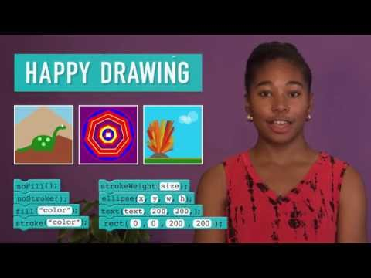
Interactive Animations and Games Lesson 3 - Activity
What’s the difference between stroke and fill?

Slide 12

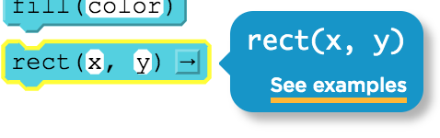

Interactive Animations and Games Lesson 3 - Activity
Code Studio, Levels 4-6
Do This
Follow the instructions on each level
If you get stuck, try…
Help and Tips Tab
Code Documentation
If you make a big mistake…
Use version history to go back

Slide 13
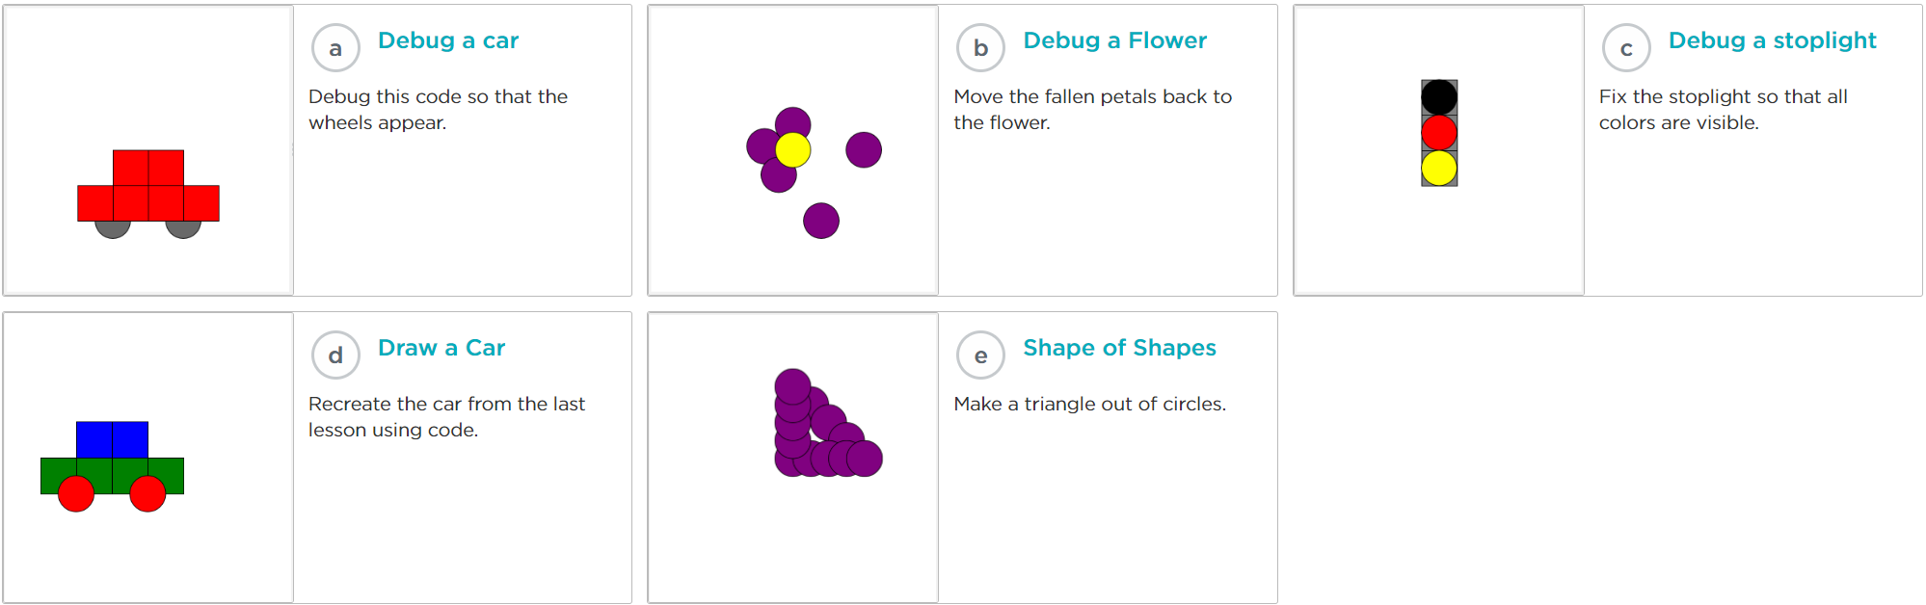
Code Studio, Level 7
Interactive Animations and Games Lesson 3 - Activity
Practice your new skills on these levels
Check with your teacher before moving on

Slide 14
Code Studio, Level 8
Interactive Animations and Games Lesson 3 - Activity
Assessment Level
Check out the "Rubric" tab
This tab appears on assessment levels
Describes how to demonstrate your understanding

Slide 15
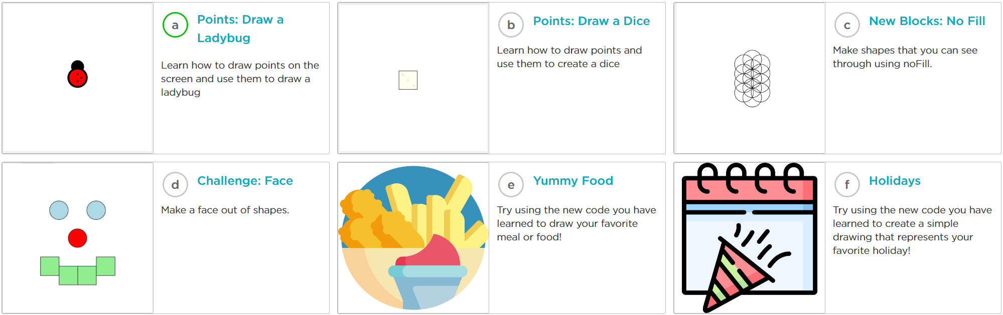
Code Studio, Level 9
Practice Level
Do This
Challenge yourself on these levels
Learn new blocks or use the same ones in new ways.
Interactive Animations and Games Lesson 3 - Activity
3 - Activity

Slide 16
Share your Creations
Interactive Animations and Games Lesson 3 - Activity
3 - Activity
Choose an image you are particularly proud of.
Share your image with others and see what they have made, too!

Slide 17


Slide 18

Interactive Animations and Games Lesson 3 - Wrap Up
Journal:
Today you learned how to draw in
Game Lab for the first time.
What type of advice would you share with a friend who was going to learn about drawing in Game Lab to make it easier for them?

Slide 19
Interactive Animations and Games Lesson 3 - Wrap Up
Question of the Day
How can we communicate to a computer how to draw shapes on the screen?

